Slide 1

TWITTER SENTIMENT ANALYSIS

Slide 2
INDEX
Introduction
Sentiment analysis
Project Requirements
Benefits of twitter sentiment analysis
Project output

Slide 3
INTRODUCTION
Twitter is a popular microblogging site with more than 240 million active users. 500 million tweets are generated everyday on twitter . Twitter audience varies from common man to celebrities. Users often discuss current affairs and share personal views on various subjects.
Tweets are small in length and unambiguous Therefore we bulid a simple project that can do sentiment analysis on twitter data to predict how people react on particular topic ? And their outcome is in the from of pie chart.

Slide 4
SENTIMENT ANALYSIS
Sentiment analysis is contextual mining of text which identifies and extracts subjective information in source material, and helping a business to understand the social sentiment of their brand, product or services while monitoring online conversations.
It is most common text classification tool that analysis an incoming message and tells whether the underlying sentiment is positive, negative or neutral.

Slide 5
PROJECT REQUIREMENT
IMPORTED PACKAGES:
Textblob :- It is a python library for processing textual data.
Tweepy :- tweepy is open sourced hosted on github and enables Python to communicate with twitter platform .
Matplotlib :- matplotlib is a comprehensive library for creating static, animated and interactive visualizations in python.
TWITTER API KEYS :
In order to access the twitter , that is to get recent tweets and twitter followers count ,you need the four keys such as
Consumer key
Consumer secret key
Access token key
Access token secret key

Slide 6
BENEFITS OF TWITTER SENTIMENT ANALYSIS
You will get clear idea about what are the opinions of pepole (positive / negative) related to following topics:
Products
Movies
Politicians
Companies
Services

Slide 7
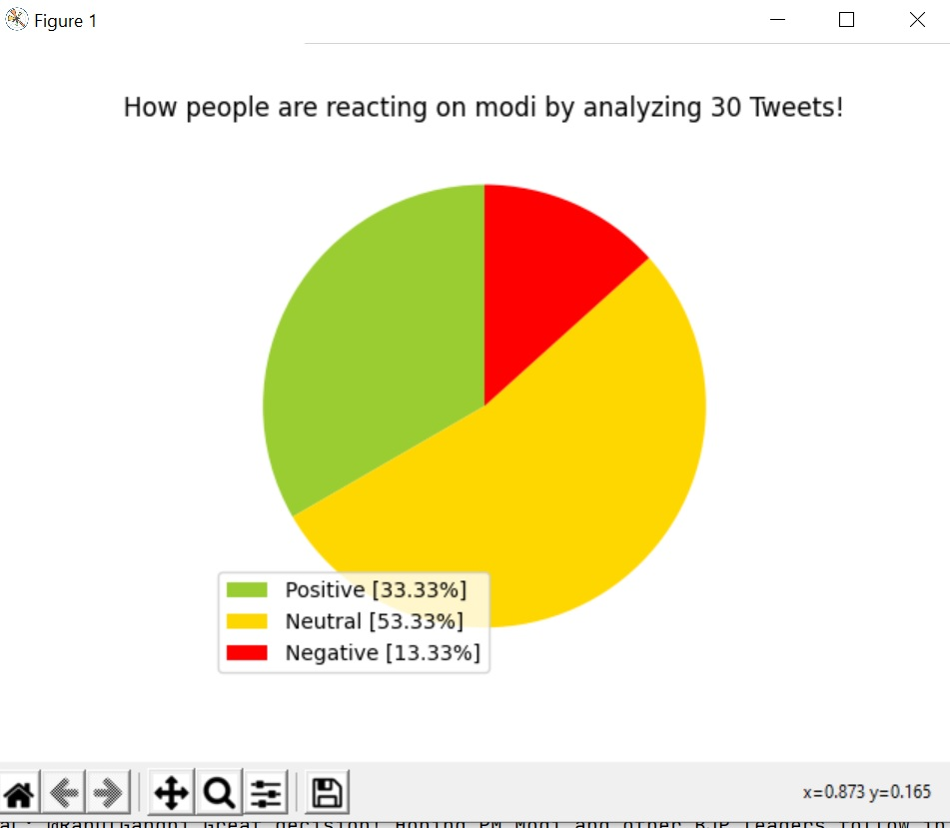
Project output

Slide 8
THANK YOU

